Slide 1


Department of CSE
DESIGN AND ANALYSIS OF ALGORITHMS
24CS2203
Topic:
Asymptotic Notations
Session - 3

Slide 2





AIM OF THE SESSION
To familiarize students with the concept of Asymptotic Notations.
INSTRUCTIONAL OBJECTIVES
This Session is designed to:
Demonstrate :- Asymptotic Notations.
Describe :- Big-Oh, Theta, Omega notations.
LEARNING OUTCOMES
At the end of this session, you should be able to:
Define :- Asymptotic Notations.
Describe :- Big-Oh, Theta, Omega notations
Summarize:- Analyze the efficiency of Algorithms.

Slide 3
Asymptotic Notations
Asymptotic notations are mathematical tools used to describe the behavior of functions, often in terms of time complexity and space complexity in computer science.
They provide a way to express the limiting behavior of a function when the argument tends towards a particular value or infinity.
There are 5 types of asymptotic notations.

Slide 4
Practical Examples
Example #1: If there are 1,000 books, you may need to check up to 1,000 shelves to find your book.
The running time will not exceed a linear relationship to the input size, hence O(n).
Example #2: If the book is the first one you check, it doesn't matter how large the library is.
The best-case time complexity will be constant, i.e., Ω(1).
Example #3: In this case, you eliminate half of the remaining books each time you check one. The time it takes to find a book grows logarithmically with the number of books.
The time complexity is logarithmic, i.e., Θ(log n).

Slide 5
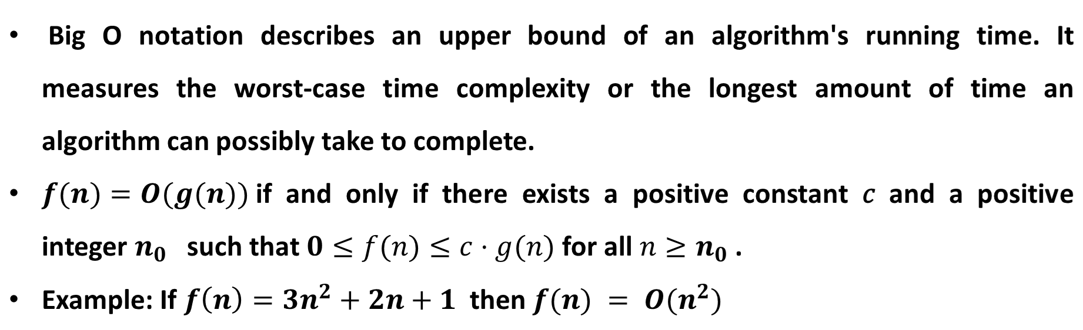
Big O Notation (O)

Slide 6
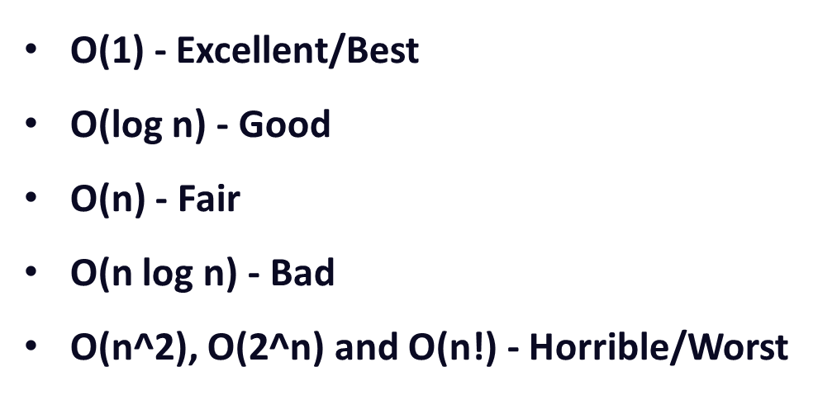
Big O - Complexities

Slide 7
Big O - Complexities
Constant Time Complexity (O(1)): The algorithm takes the same amount of time regardless of the input size. It means the number of operations remains constant. Example: accessing a specific element in an array.
Logarithmic Time Complexity (O(log n)): The runtime grows logarithmically as the input size increases. Typically occurs in algorithms that divide the problem into smaller chunks and process each chunk independently. Example: binary search in a sorted array.
Linear Time Complexity (O(n)): The runtime increases linearly with the size of the input. Each additional element in the input contributes proportionally to the time taken. Example: iterating through an array to find a specific element.

Slide 8
Big O - Complexities
Quadratic Time Complexity (O(n^2)): The runtime is proportional to the square of the input size. This often occurs with nested loops where each loop iterates over the entire input. Example: nested loops to compare all pairs of elements in an array.
Exponential Time Complexity (O(2^n)): The runtime doubles with each addition to the input size. These algorithms multiply and can become impractical for large inputs. Example: generating all subsets of a set using recursion.
Factorial Time Complexity (O(n!)): A naive approach would be to try every possible permutation resulting in an O(n!) time complexity. For example, the traveling salesman problem.

Slide 9
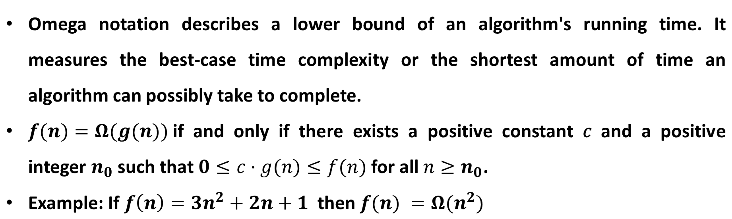
Omega Notation (Ω)

Slide 10
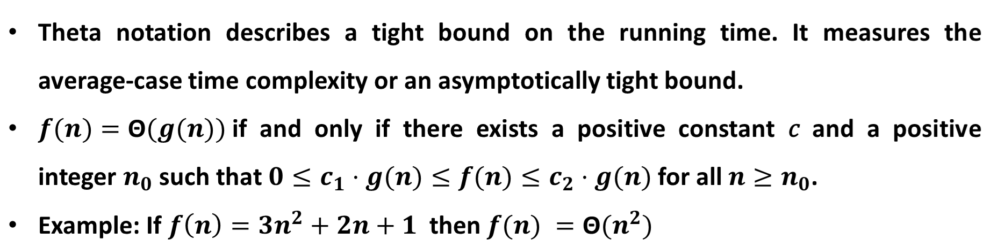
Theta Notation (Θ)

Slide 11
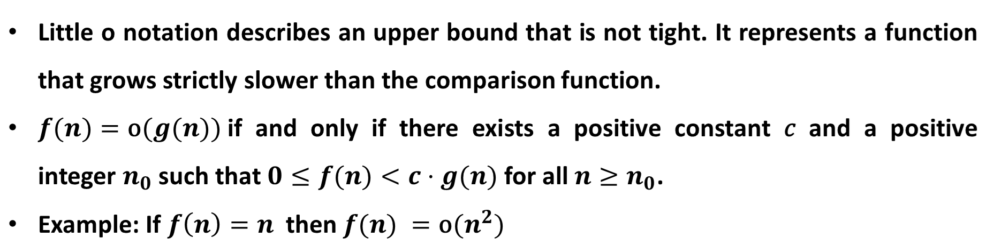
Little o Notation (o)
This means that the linear algorithm grows strictly slower than the quadratic one.

Slide 12
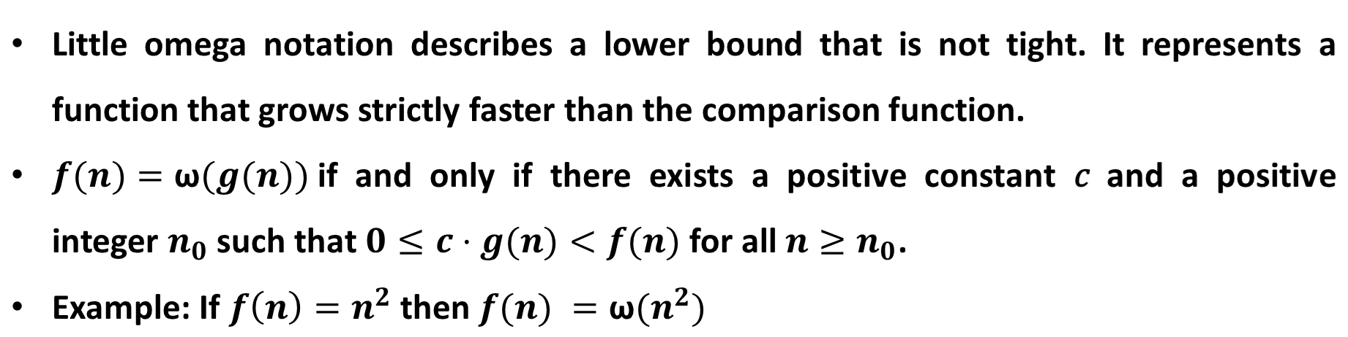
Little omega Notation (ω)
When one function grows strictly faster than another, we say that the latter function grows slower asymptotically compared to the former. Specifically, if a function f(n) is ω(g(n)), it indicates that as n approaches infinity, g(n) grows asymptotically slower than f(n).

Slide 13
Visual Summary
O(g(n)): Upper bound (worst-case)
Ω(g(n)): Lower bound (best-case)
Θ(g(n)): Tight bound (average-case)
o(g(n)): Upper bound (strictly less)
ω(g(n)): Lower bound (strictly more)

Slide 14
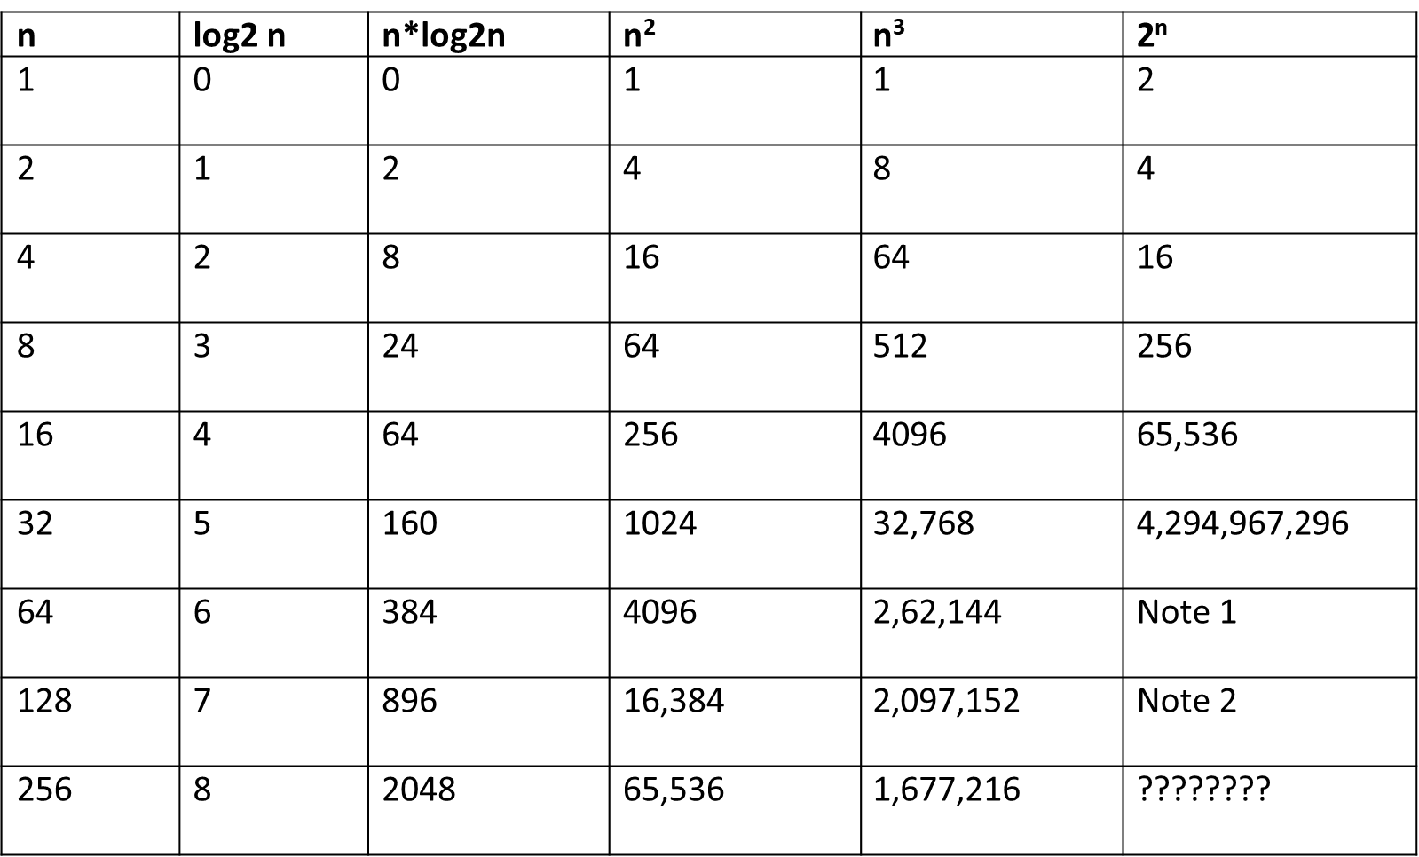
Numerical Comparison

Slide 15
Example
low = 0
high = n-1
while low <= high:
mid = (low + high) // 2
if array[mid] == target:
return mid
elif array[mid] < target:
low = mid + 1
else:
high = mid - 1
return -1
for i = 0 to n-1:
if array[i] == target:
return i
return -1

Slide 16
Example
for i = 0 to n-1:
for j = 0 to n-i-1:
if array[j] > array[j+1]:
swap(array[j], array[j+1])
for i = 1 to n-1:
key = array[i]
j = i-1
while j >= 0 and array[j] > key:
array[j+1] = array[j]
j -= 1
array[j+1] = key

Slide 17
SUMMARY
Asymptotic notation provides a simplified way to analyze and compare the efficiency of algorithms, focusing on their growth rates without being concerned with constant factors and lower-order terms.
Asymptotic notations are mathematical tools to express the time complexity of algorithms for asymptotic analysis.

Slide 18
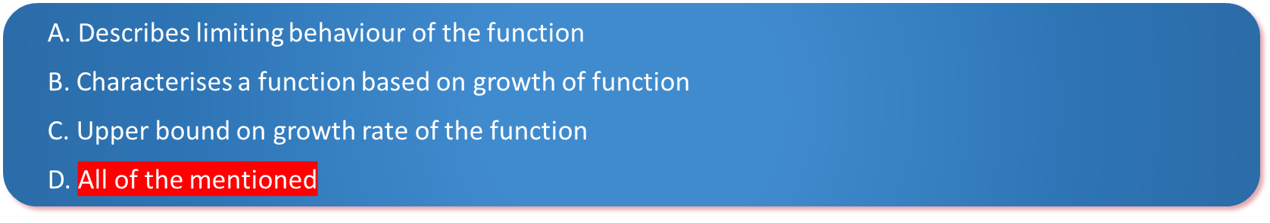
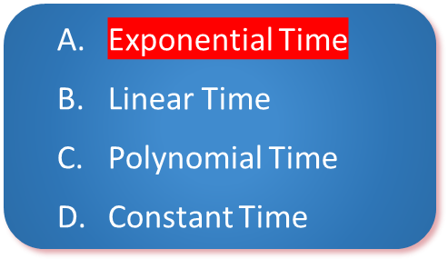
SELF-ASSESSMENT QUESTIONS
To measure Time complexity of an algorithm Big O notation is used which?
2. The number of executions grows extremely quickly as the size of the input increases

Slide 19
TERMINAL QUESTIONS
What does it mean when we say that an algorithm X is asymptotically more efficient than Y?
Find upper bound of running time of a cubic function f(n) = 2n³ + 4n + 5.?
Write the asymptotic notations use. for best case ,average case and worst case analysis of algorithms.

Slide 20
REFERENCES FOR FURTHER LEARNING OF THE SESSION
Text Books :
1. Ellis Horowitz, Sartaj Sahni and Sanguthevar Rajasekaran, “Fundamentals of ComputerAlgorithms”, 2nd Edition, University Press, 2008.
2. Cormen, Leizerson &Rivest, “Introduction toalgorithms”, 3rd Edition, Prentice-Hall, 2002.
3. Jon Kleinberg and Eva Tardos, “Algorithm Design”,Pearson Education, 2006.
Reference Books :
1. Robert Sedgewick and Kevin wayne , “Algorithms”, 4th edition, Addison WesleyProf.,(2011).
2. Anny Levitin, “Introduction to Design and Analysis of Algorithms”, 2rd Edition, PersonEducation Press. (2007).
3. Michael T.Goodrich and Roberto Tamassia, Algorithm Design: Foundations,Analysis and Internet Examples, Second Edition, Wiley-India, (2006).
4. Steven S. Skiena, “The AlgorithmDesign Manual”, Second Edition, Springer, (2008)
MOOCS :
1. https://www.coursera.org/specializations/algorithms?= 2.https://www.coursera.org/learn/dynamic-programming-greedy-algorithms#modules

Slide 21
THANK YOU

